Slide 1
MI-SBTDCTM – Feet on the Street!

Slide 2
WHO ARE WE?
Michigan’s most comprehensive small business assistance program
Funded through three sources:
  Small Business Administration (SBA)
  Michigan Economic Development Corp. (MEDC)
  Local network of partners in universities, colleges and economic development offices

Slide 3
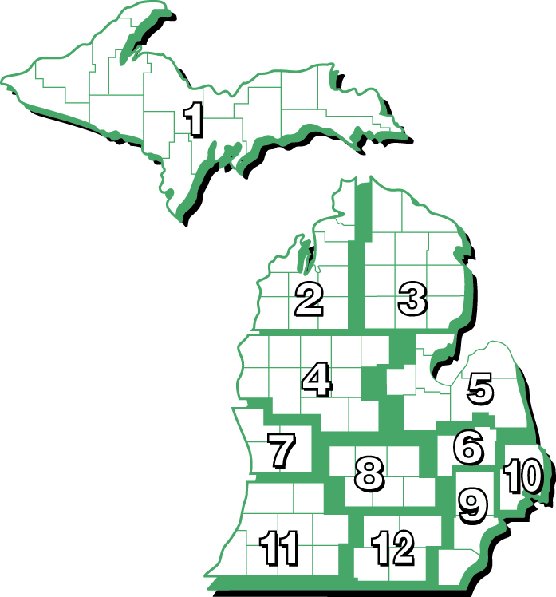
WHERE ARE WE LOCATED?
State Headquarters
Grand Valley State University
Seidman College of Business
12 Regional Offices
www.misbtdc.org
Notes:
3

Slide 4
Who are our staff?
Regional Team
  Lead consultants – maintain ongoing relationship
  Core services – deliver or build team for client needs
Growth Group
  Well established / 2nd stage business specialists
Manufacturing Assistance Team
  Manufacturing finance and diversification specialists
Technology Team
  Innovative technology-based business specialists

Slide 5
What are our core services?
Counseling ▪ Training ▪ Market Research
BUSINESS COUNSELING/COACHING
– no cost/confidential
SECONDARY MARKET RESEARCH
– low or no cost
BUSINESS EDUCATION
– low or no cost

Slide 6
What key things does a business consultant assist a client with?
Counseling ▪ Training ▪ Market Research
  Business Plan Development
  Financial Analysis
  Capital Access Planning
  Cash Flow Management
  Strategic Planning
  New Market Development / Diversification

Slide 7
How do we assist a business in the area of financial analysis?
Analyze data from financial statements for past 3-5 years:
  Breakeven
  Profits: Gross, Operating and Net
  Working Capital, Inventory and Accounts Receivable
  Asset Turnover
  Cash Flow
  Return on Assets
  Interest and Debt Service Coverage
Benchmark company against industry financial ratios
Identify performance opportunities - “What If” and scenario building
Goal: Assess company’s financial health and increase understanding of opportunities to improve financial position

Slide 8
What is the role of a consultant related to accessing capital?
Assess capital and cash flow needs
Assist with development of a business plan, financial forecast, loan proposal, and lender presentation
Educate clients on financial ratios and lending criteria used by financial institutions
Connect the business owner with appropriate funding sources
Post-funding consulting to maximize success and promote an ongoing strong relationship with the bank or other funding source

Slide 9
What are the capital access paths pursued?
SBA Programs www.sba.gov
  Regular 7(a) and SBA 504 Program
  Export Assistance Working Capital
Small Business Innovative Research grants (SBIR) and Emerging Technologies Fund (ETF)
Angel and Venture Capital
MEDC Programs
http://www.themedc.org/Products-Services/A-Z-Programs/Default.aspx
  Capital Access Program
  Michigan Loan Participation Program
  Michigan Collateral Support Program
Credit Unions
USDA, Microloan Funds, Revolving Loan Funds, Others…

Slide 10
How is market research obtained?
Counselors support clients with market, industry and competitive information
Available from two dedicated research gathering centers at:
  Seidman College of Business at GVSU
  University of Texas San Antonio

Slide 11
What are our sources of data?
Dun & Bradstreet 653
J.J. Hillsearch 580
Scan US 346
Other 315
Online Research 230
RMA Ratio Comparisons 152
Lifestyles Market Analyst 099
BizComps 007
Data from 2009

Slide 12
What business education is provided?
Training programs serve as an efficient method of increasing entrepreneurial skills prior to or in conjunction with counseling
Programs are offered for all stages of business development
  Start up (< two years)
  Emerging (< five years, < 10 employees)
  Established / 2nd Stage (>10 employees / $1million in sales)

Slide 13
What training is available for early stage businesses?
Start-up and Emerging Businesses may do half-day Entrepreneurial Series Programs
  Fundamentals of Starting a Business
  Fundamentals of Writing a Business Plan
  Fundamentals of Marketing Your Business
  Fundamentals of Finance
  Fundamentals of Business Legal Issues

Slide 14
What about in depth
FastTrac Bootcamps?
We also offer the FastTrac NewVenture program for start-ups
  Developed and provided through the Kaufman Foundation
  An in depth, 10-week, certified facilitator-led program
  Supported by ongoing and follow-up MI-SBTDC counsel for participants
  Goal: A strong business plan

Slide 15
What about training for established / 2nd stage businesses?
Advanced training programs target businesses with >10 employees or >2 years history
  FastTrac GrowthVenture
  FastTrac Tech Venture
  Fiscal Fitness (Understanding Financials)
  PeerSpectives “CEO Roundtables”
  Retail Survival Guide
  The Successful Contractor

Slide 16
What specialists exist?
The Regional Team is supported by a statewide cadre of consultants skilled at providing SBTDC programs for established and 2nd Stage businesses
Specialists:
MAT (Manufacturing Assistance Team)
G2 (The Growth Group)
Tech Team

Slide 17
What is the focus of the (MAT)
Manufacturing Assistance Team?
Created in 2009 in response to economic stress in the Michigan manufacturing sector
Dedicated to working with small and medium-sized Michigan manufacturers
Expertise in team assists specifically in areas of: financial planning and control, access to capital, and strategic assessment and improvement

Slide 18
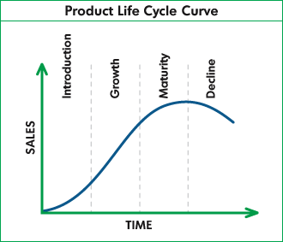
Who does the growth group (G2) serve?
Counseling ▪ Training ▪ Market Research
Targeted to assist companies intending to grow
Diverse industries: manufacturing, service and retail
Revenues between $1 million and $50 million
9 – 99 employees
Team has expertise and provides assistance in financial, manufacturing, strategic planning, and marketing

Slide 19
What tools are used to assist the Business owner?
Counseling ▪ Training ▪ Market Research
Strategic Needs Assessment
Financial Analysis
Capital Needs
Organizational Development
Strategic Actioning
Marketing Edge
Process Improvement
Capital Access
Internal Management Tools
Monitor and Analyze Metrics
Implementation Accountability
Quarterly Variance Analysis
Leadership Coaching
Step 1: Assess and
strengthen company
Step 2: Assess future
growth opportunities
Step 3: Implement
growth plan & monitor
Notes:
Note that this chart is designed to show the in-depth, systematic approach that is taken with G2 clients as part of their “protocol”.

Slide 20
What does the “T” in the SBTDC mean?
Technology Company Definition:
A business in which research and development brings forth an innovative product or process. The innovation typically involves intellectual property that contributes to a strong competitive advantage in the marketplace, and serves as a foundation for a high rate of growth.
Key Services that Specialists Provide Include:
Intellectual Property Guidance
SBIR/STTR Assistance
Preparation for Angel/Venture Capital Pitch Presentation
Commercialization Planning via Technology Roadmapping
Management Team Assistance
Strategic Alliance Building
Marketing

Slide 21
WHAT DOES THE SBTDC TOUT?
THE MI-SBTDC IS:
  Client centered
  Efficient (triage system)
  Collaborative
  Focused on economic impact
    Jobs – created and retained
    Sales
    Capital – loans, owner investment, outside investment
    New business starts

Slide 22
QUESTIONS ?
“The SBTDC has been a fantastic resource for both new business ventures and more mature businesses looking to grow or improve their operating performance. The SBTDC has formed a strong partnership with Mercantile Bank of Michigan to help promote and sustain our local economy by providing various counseling and / or training opportunities to our current and future customers. These resources are invaluable to our local businesses!”
Lindsay Spitler
Assistant Vice President
Mercantile bank of Michigan

